Slide 1
Tensorflow vs PyTorch
Team 5: Caitlin Bryant, Skyler Liu,
Danilo Nikcevic, Cory Wall

Slide 2


Problem Statement
In class we only use Tensorflow. In this presentation we are going to provide research and a code demo for both pytorch and tensorflow.
Pros/Cons and when to use.

Slide 3
Research Paper
Analysis of the Application Efficiency of TensorFlow and PyTorch in Convolutional Neural Network
This paper presents an analysis of important aspects that arise during the development of neural network applications.
The comparison between the libraries revealed six criteria:
user-friendliness, available documentation, ease of integration, overall training time, overall accuracy, and execution time during evaluation

Slide 4
User-friendliness
User-friendliness represents the first aspect to consider when developing a neural network.
Available Documentation
Documentation support is another aspect tied to the “Design Phase” of a neural network and, similar to user-friendliness, it can have a significant impact on development time.
Ease of Integration
an easy to integrate library will mean that minimal time is spent setting up the environment, ultimately allocating more time to actual network design.
Overall Training Time
This aspect refers to how much time is spent during the training of the neural network.
Overall Accuracy
represents the whole purpose of building a neural network, that being to provide sufficiently accurate results
Execution Time During Evaluation
the time it takes for results to be generated during evaluation.

Slide 5
User-friendliness
Documentation Support
Integration with the Developed Platform
While each function had a clearly defined role and could be easily traced in both cases, the function calls themselves presented a more complex implementation in the case of TensorFlow
For each instance, both libraries offered clear and concise information regarding the usage of modules and eventual solutions to problems.
As both PyTorch and TensorFlow offered easy-to-use interfaces, the integration step was completed with relatively low errors

Slide 6
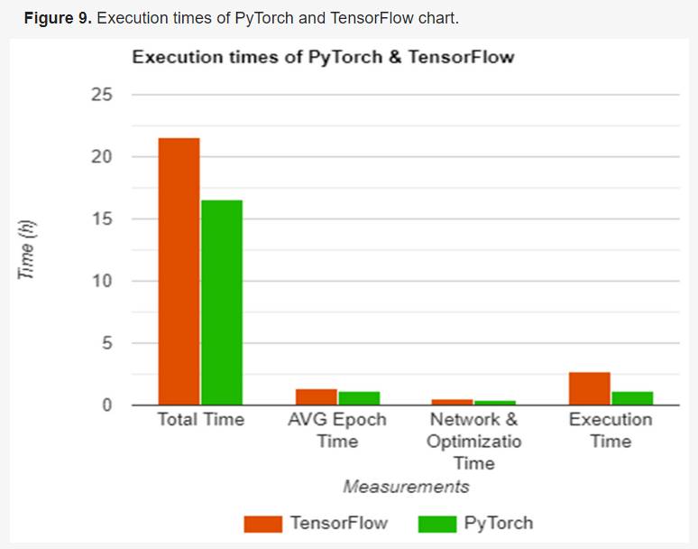
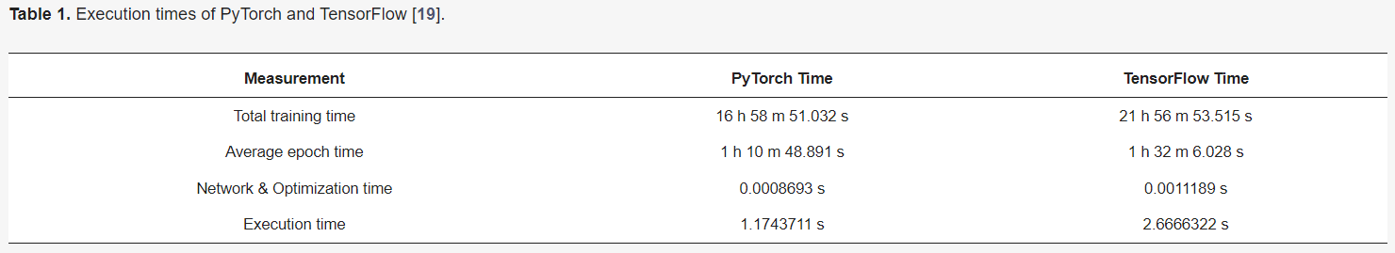
Training & Execution Times
Notes:
As seen in Table 1 and Figure 9, there are a few differences between the registered performance of each library, with an average difference of 25.5% in training mode, which can be further broken down into 25.5% for total training time, 26.1% in average network time, and 25.1% during the network training and optimization step.
Similar results were obtained during the evaluation step, however, on a larger scale, with PyTorch being faster by 77.7%.

Slide 7
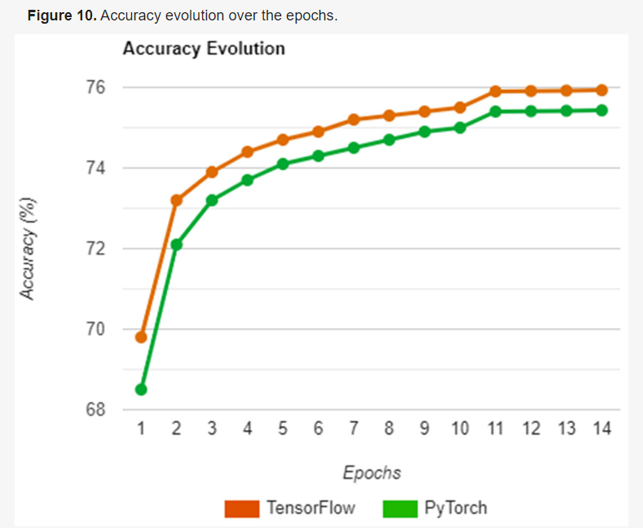
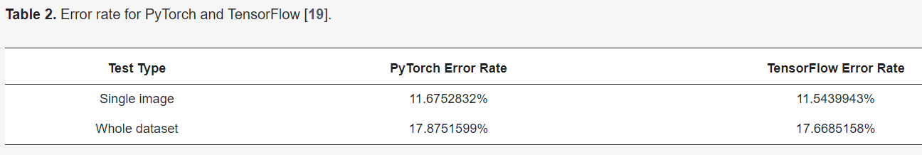
Accuracy during Training & Execution
Notes:
the measurement was used in two separate tests which aimed to describe the accuracy obtained on a single image pair and a whole dataset.
Table 2 shows the results of each test, both being run on the two libraries and having a separate column for each result.
As seen in Table 2 and Figure 10, the results are in reverse of what was obtained in previous section, with TensorFlow having better accuracy both in the single and overall tests.

Slide 8
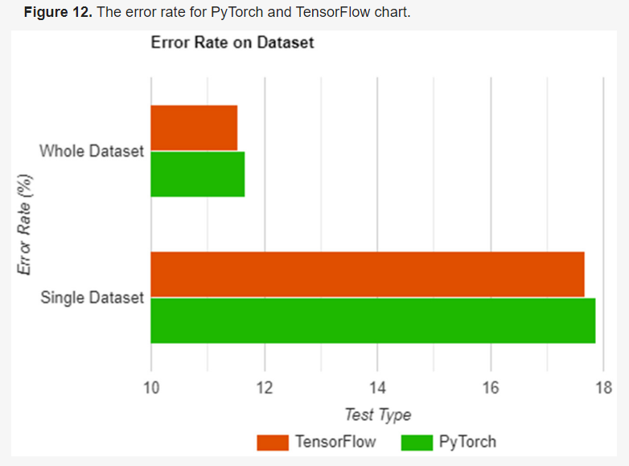
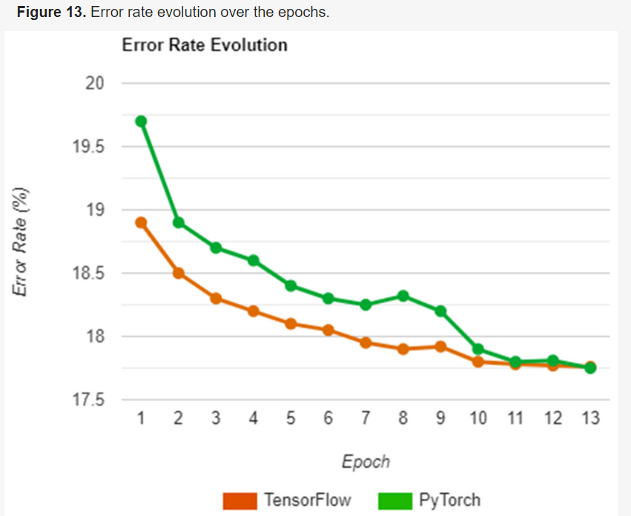
Notes:
As seen above, the two libraries follow a similar path in terms of error rate, with TensorFlow having better initial accuracy and maintaining the lead until the end with a difference of 1.16%. Moreover, PyTorch also presents a less stable evolution, particularly in epoch 8 where the error rate jumps upwards by a significant amount.

Slide 9
Code Demo
Build the same neural network in Tensorflow and Pytorch to compare models and syntax using the digit MNIST dataset
Notes:
https://colab.research.google.com/drive/1KcLXyvx_1tx8v7pEs2QdeSXgyG_bP9TP?authuser=1#scrollTo=1c5a4323
https://colab.research.google.com/drive/1ZVxHi8xWidSm3fgyc4GxeV62yiXzwwHA?authuser=1#scrollTo=5bf51ad1
https://drive.google.com/file/d/1KcLXyvx_1tx8v7pEs2QdeSXgyG_bP9TP/view?usp=sharing
https://drive.google.com/file/d/1ZVxHi8xWidSm3fgyc4GxeV62yiXzwwHA/view?usp=sharing

Slide 10
Conclusion
Tensorflow
better for experienced users
higher accuracy
clear and concise documentation support
PyTorch
beginner friendly
more time efficient
clear and concise documentation support
Future development?
Notes:
PyTorch is shown to be focused on the “Design Phase”, with a more user-friendly interface due to it having more functions defined by default—cosine similarity—all while also being easier to integrate in solutions, with a single command to install and no external dependencies.
PyTorch is better suited for learning or tasks where speed is prioritized as it offers a more beginner-friendly experience due to a simpler installation process, easy-to-follow dataflow, and overall easier integration, with higher training speeds
TensorFlow, in contrast, is better used by experienced users and in tasks where accuracy takes priority, as it offers more flexibility in both the integration process—any CUDA version compared to PyTorch’s fixed version—as well as in how a network can be defined and trained, with more control over the training flow due to complexity, resulting in a higher overall accuracy.

Slide 11
Sources
Novac, O.-C., Chirodea, M. C., Novac, C. M., Bizon, N., Oproescu, M., Stan, O. P., & Gordan, C. E. (2022, November 16). Analysis of the application efficiency of tensorflow and pytorch in Convolutional Neural Network. MDPI. Retrieved April 12, 2023, from https://www.mdpi.com/1424-8220/22/22/8872
Symbl, T. (2022, September 16). Building the same neural network in tensorflow and pytorch. Symbl.ai. Retrieved April 12, 2023, from https://symbl.ai/blog/building-the-same-neural-network-in-tensorflow-and-pytorch/

